Slide 1


Mac Installation & Activation -Basic Troubleshooting-

Slide 2
Topics to be covered
Mac Terminology
Office for Mac Installation & Activation
Uninstall Office from Mac
Removal Tools available for Mac
Troubleshooting signing-in issues using Mac’s Keychain tool.

Slide 3

Mac Terminology

Slide 4
About Mac users…
MacOS has its own way of naming things. Something that we need to keep in mind is that many Mac users are fans of the Apple products they own, therefore some of them may feel uncomfortable if we do not name things correctly.
The next slide will display some components of the MacOS user interface and its closest equivalent found in a Windows system.

Slide 5
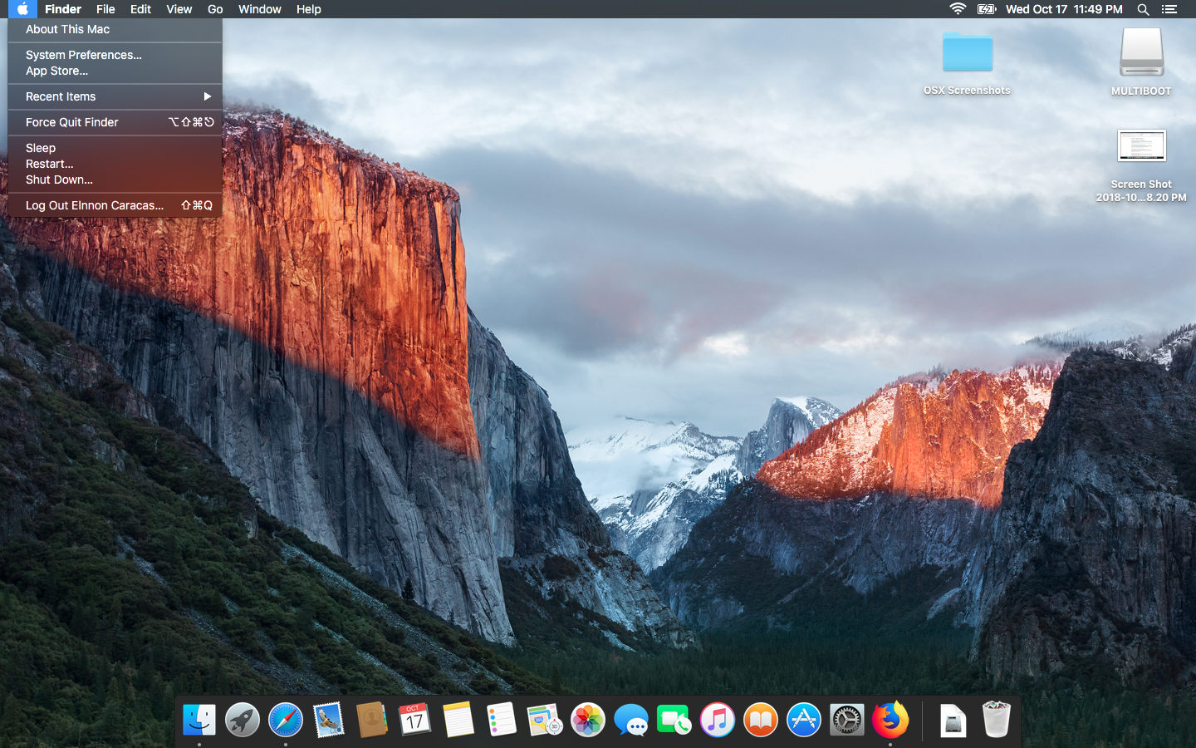
The MacOS Desktop

Slide 6


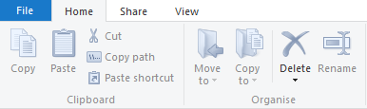
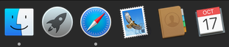

Mac Item
Windows Equivalent
Finder
Application Menu
Dock
Windows Explorer
Ribbon Menu
Taskbar

Slide 7

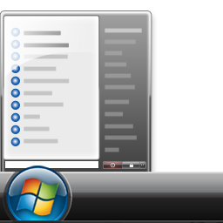




Mac Item
Windows Equivalent
Launchpad
Alias
System Preferences
Start Menu
Shortcut
Control Panel

Slide 8




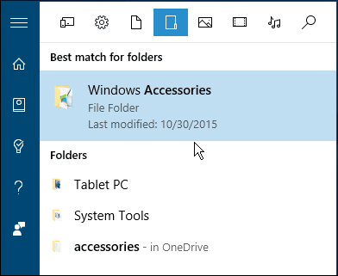


Mac Item
Windows Equivalent
Terminal
Utilities
Trash can
Command Prompt/PowerShell
Windows Accessories
Recycle bin

Slide 9


Office for Mac Installation

Slide 10

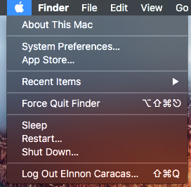
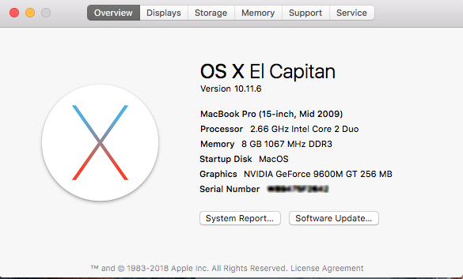
1. Check the MacOS version
Supported MacOS Versions:
Office 2019 & 365: MacOS 10.12 “Sierra” and above.
Office 2016 & 365: MacOS 10.10 “Yosemite” to 10.13 “High Sierra”
You can achieve this by going to the apple ( )icon, and selecting the option “About this Mac”

Slide 11
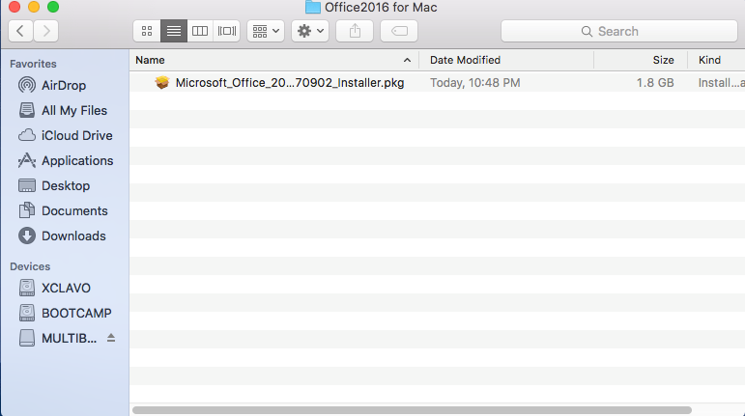
2. Get the Office for Mac Installer
Sign in to customer’s account through https://account.microsoft.com and download the installer through the “Services and Subscriptions” tab.

Slide 12
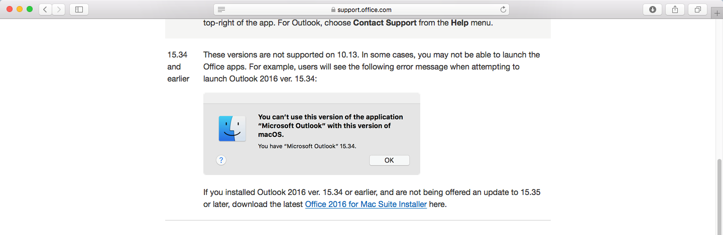
Pro-Tip: Other ways to get the Mac Installer
If for some reason you cannot download the Mac installer from customer’s account, you may download it straight from support.office.com. Just search for the keywords “High Sierra Support” or “Mojave Support”.

Slide 13
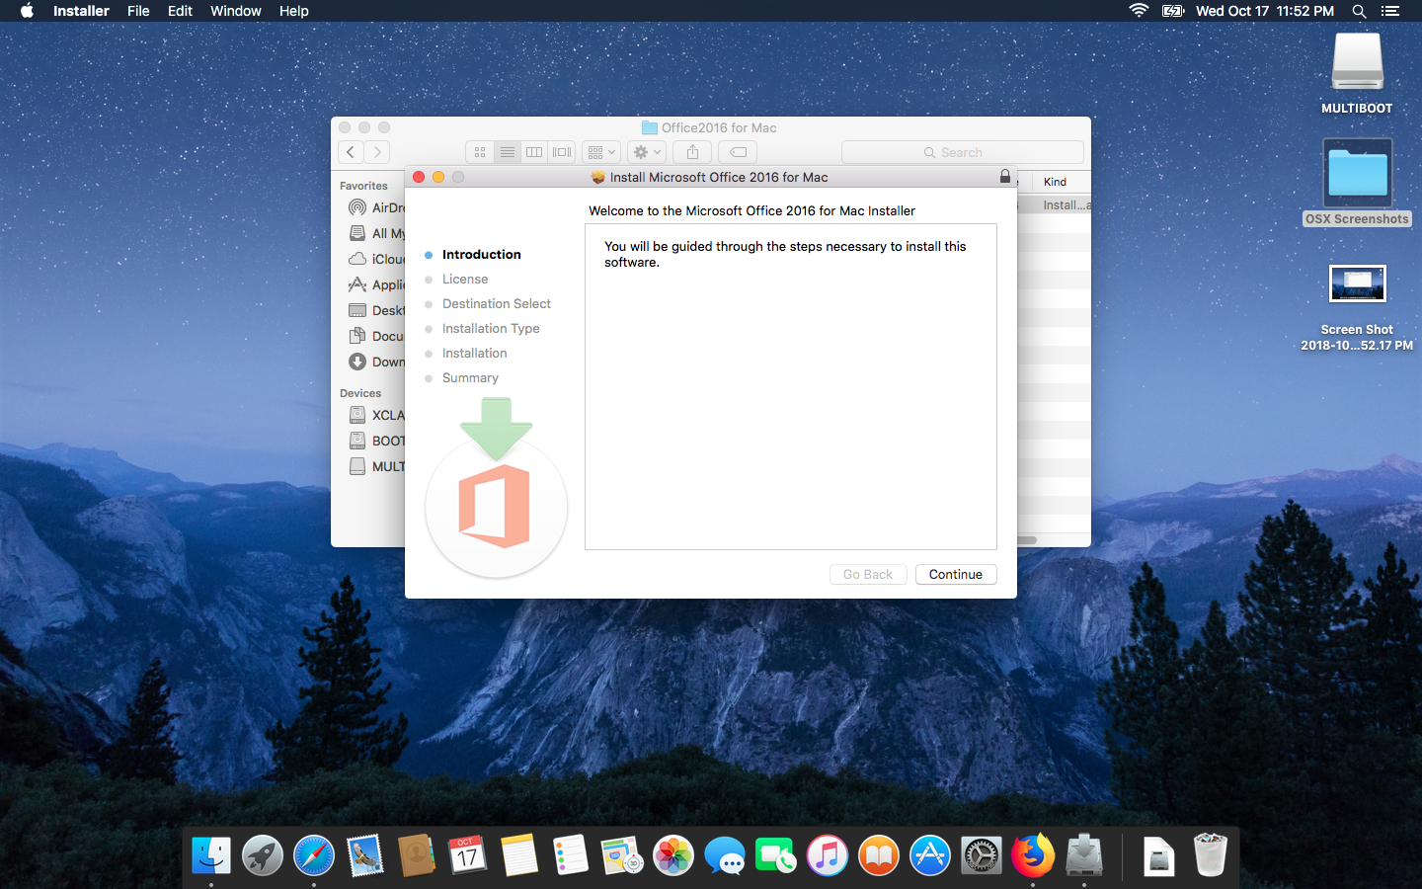
3. Run the Installer

Slide 14
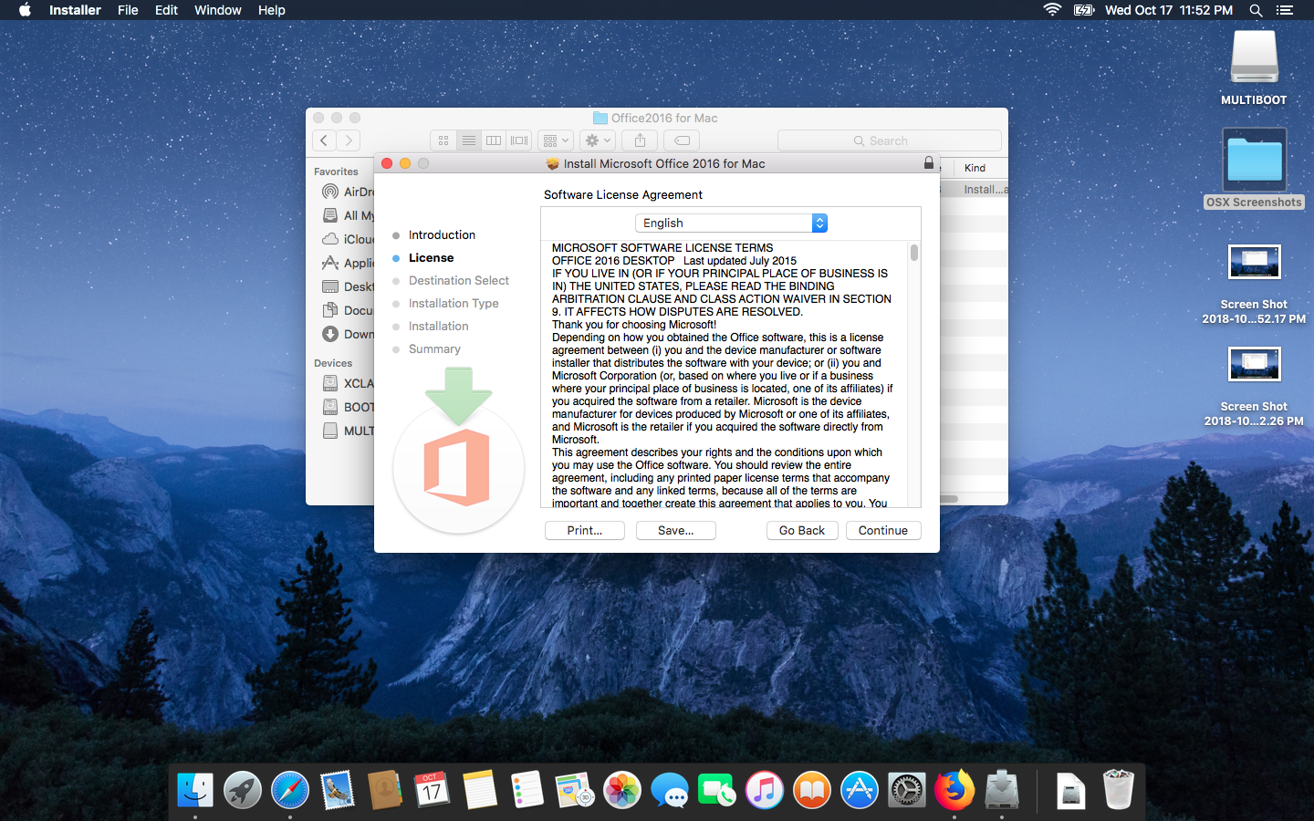
3.1 License Agreement

Slide 15
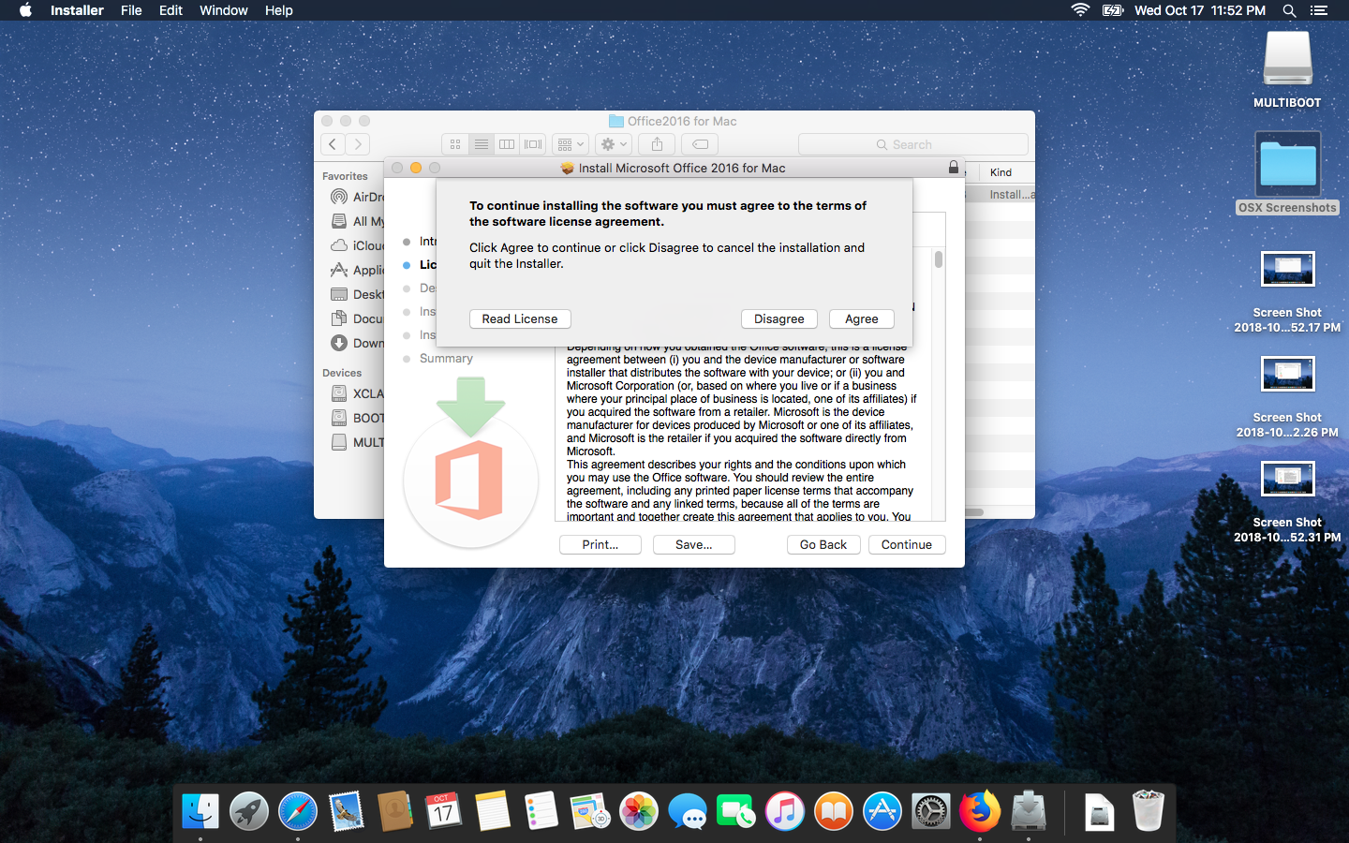
3.2 Accept Agreement

Slide 16
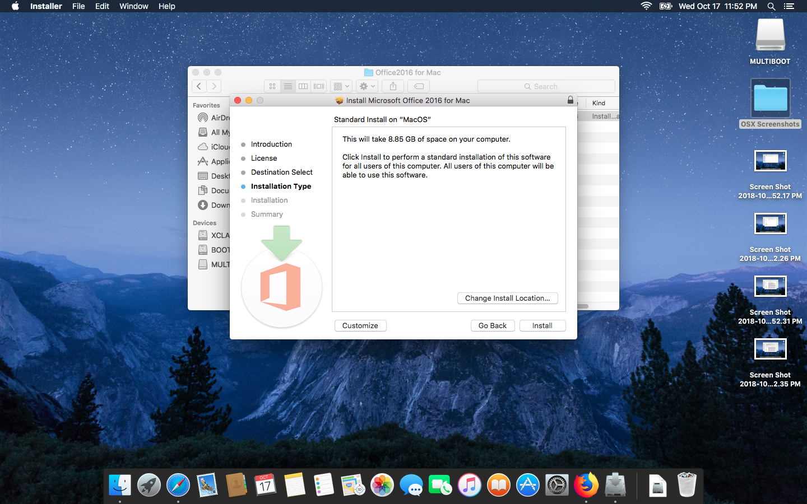
3.3 Select Install Location – Install

Slide 17
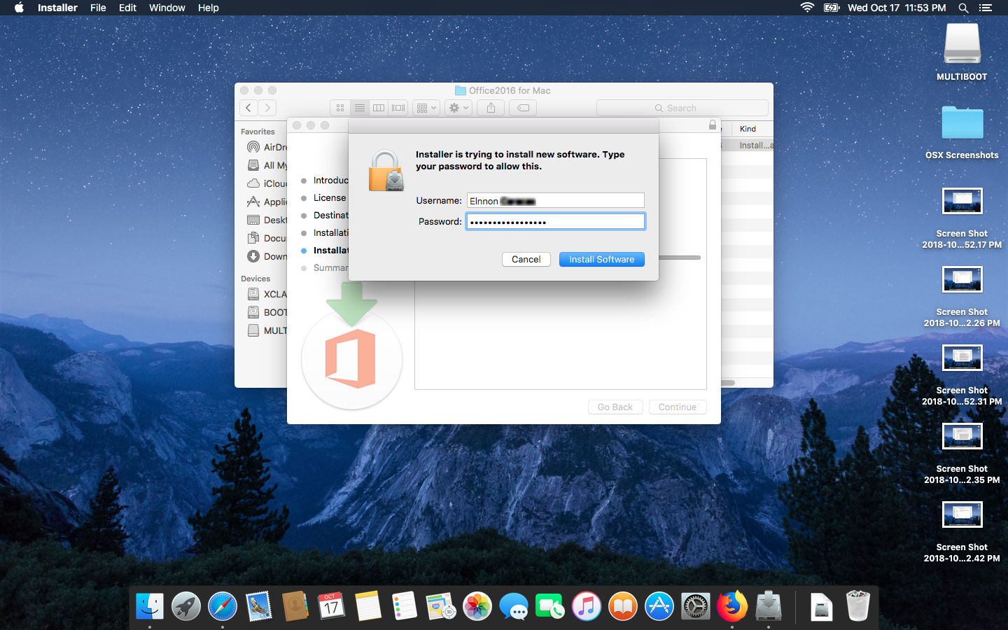
3.4 Enter Admin Password

Slide 18
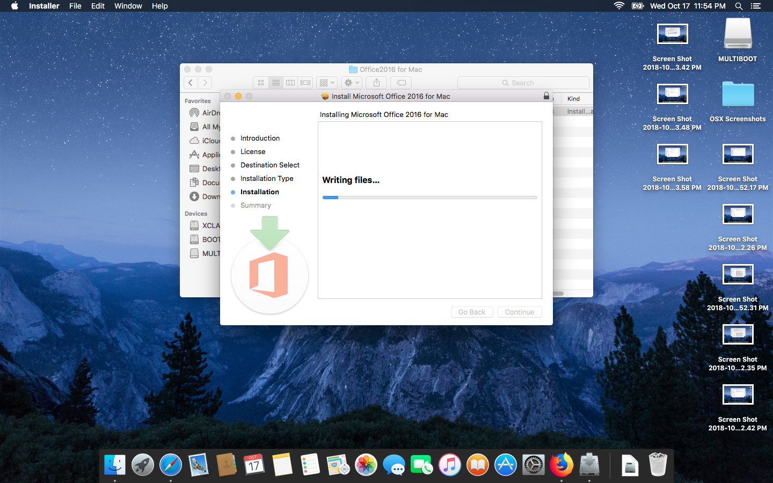
Installing.

Slide 19
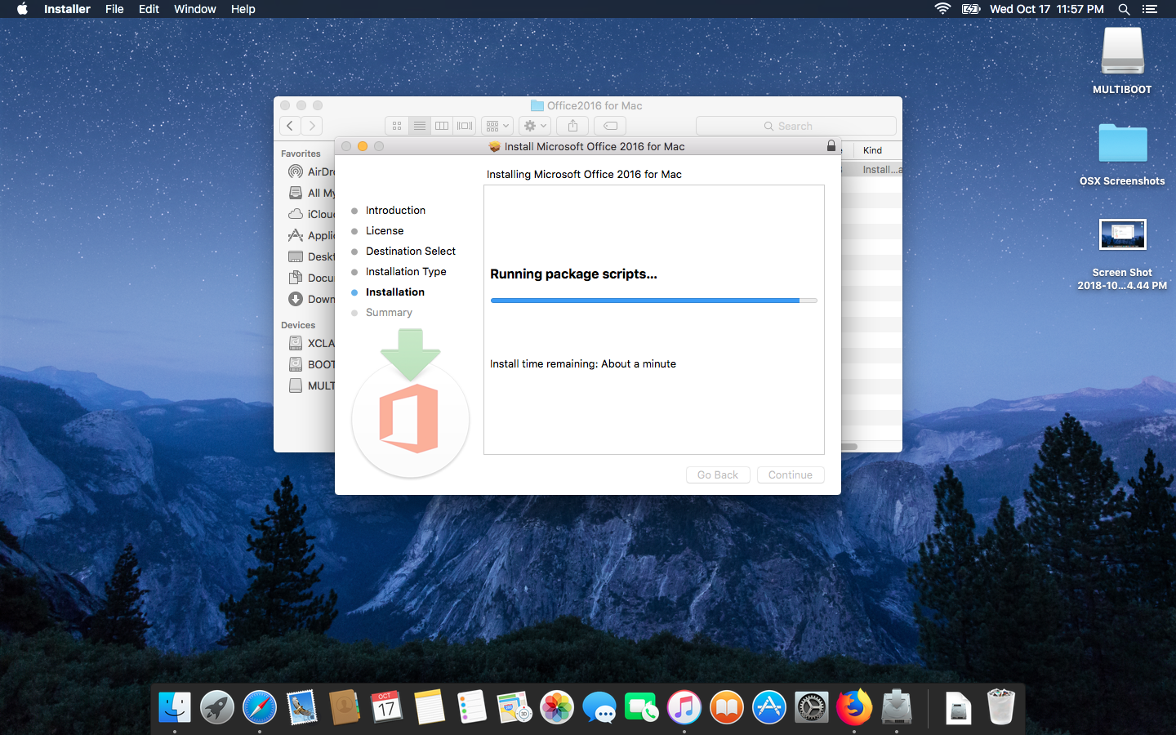
Installing..

Slide 20
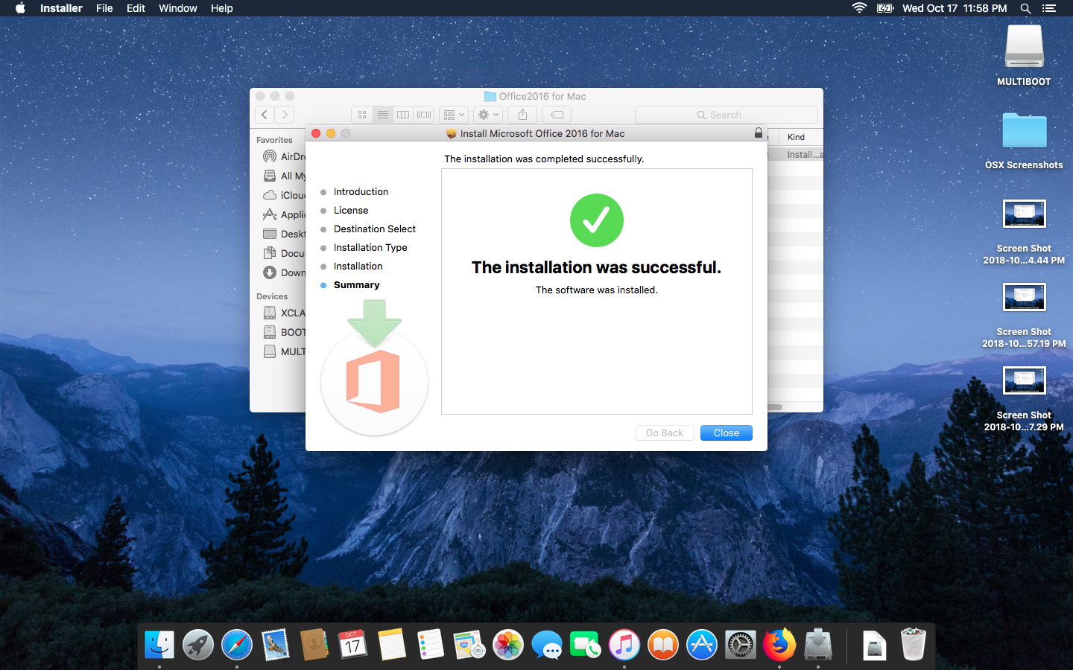
Installing… Done!

Slide 21
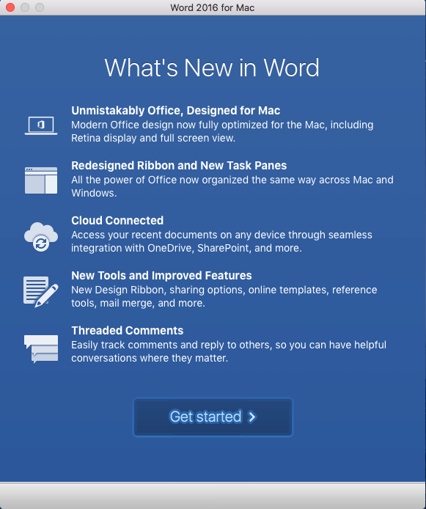
4. Activate Office
Open any Office App. The first time you run Office you will get this screen.
Click Get Started

Slide 22
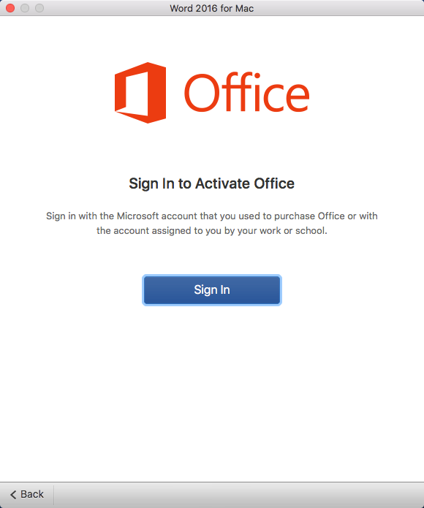
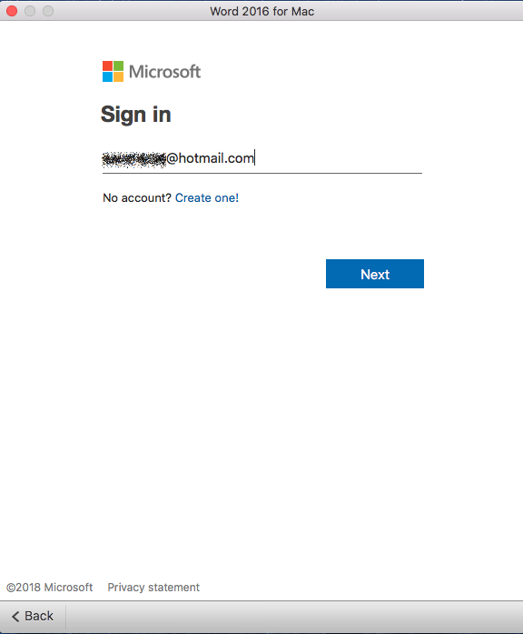
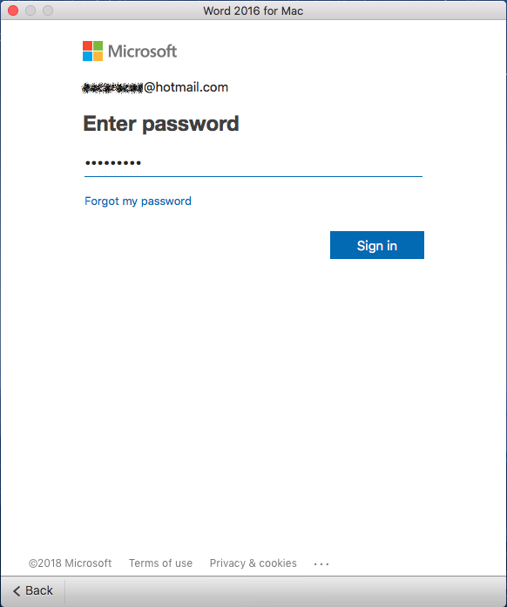
5. Sign-in to Activate

Slide 23
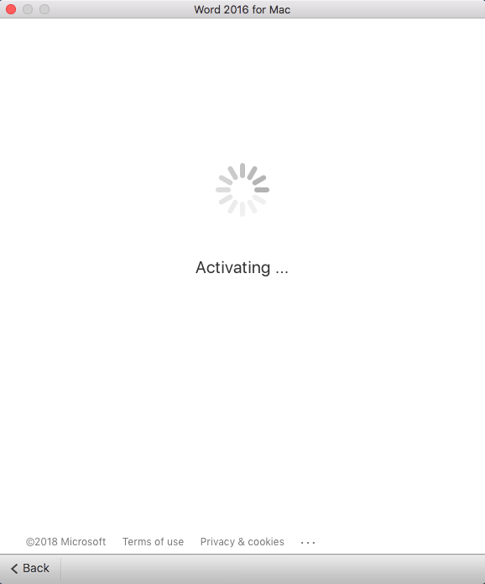
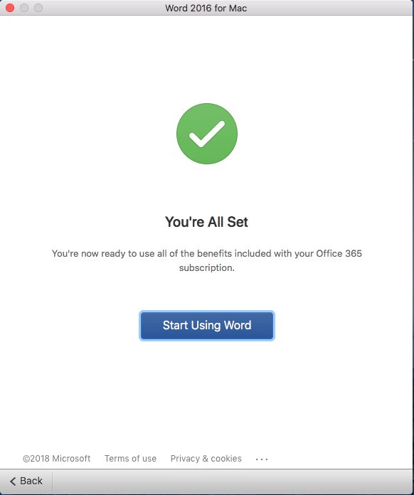
6. Profit…!

Slide 24
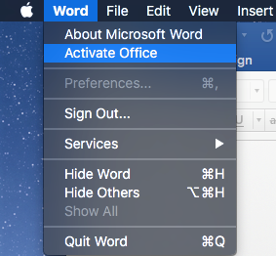
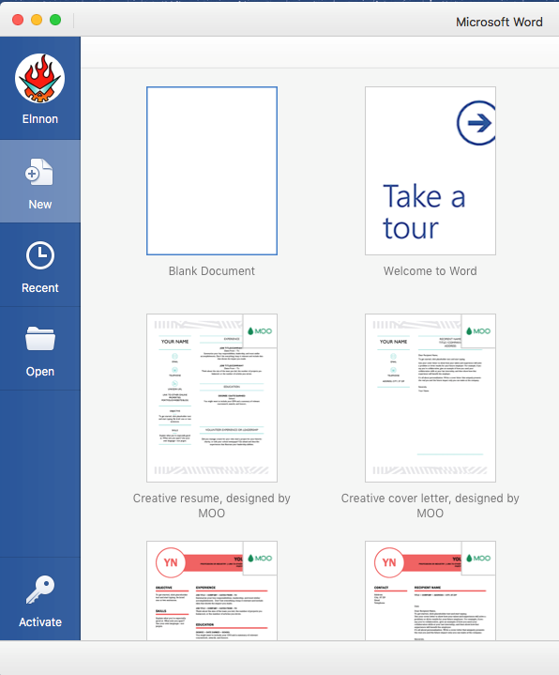
Other ways to launch the activation wizard.

Slide 25
Uninstalling Office from Mac

Slide 26
3. Run the Installer

Slide 27
3. Run the Installer

Slide 28
3. Run the Installer

Slide 29
3. Run the Installer

Slide 30
3. Run the Installer

Slide 31
3. Run the Installer

Slide 32
3. Run the Installer

Slide 33
3. Run the Installer

Slide 34
3. Run the Installer

Slide 35
3. Run the Installer

Slide 36
3. Run the Installer

Slide 37
3. Run the Installer

